Slide 1

ANNAMACHARYA INSTITUTE OF TECHNOLOGY & SCIENCES
(AUTONOMOUS)
UTKUR (P), C.K. DINNE (V&M), KADAPA, YSR DIST
Approved by AICTE, New Delhi & Affiliated to JNTUA, Anantapuramu.
Approved by S.B.T.E.T. Andhra Pradesh.
Accredited by NAAC with ‘A’ Grade, Bangalore & NBA (EEE, ECE, CSE)
SPAM CLASSIFIER USING NAÏVE BAYES
Presenting By
22HM1A05B9 S.RUCKSAR
22HM1A05C9 S.SUVARNA 22HM1A05E0 V.S.MD.KHALID
23HM5A0521 S.VIDYASREE 22HM1A05A7 R.KAVYASREE
22HM1A05D0 S.UMAR 22HM1A05E1 V.CHAKRADHAR
23HM5A0522 S.AFRID 22HM1A05A8 S.MOKSHAGNA
22HM1A05C0 S.SADIYA 22HM1A05D1 T.V.CHARANSAI

Slide 2
Table of contents
Introduction
Objective
System Analysis
Naive Bayes Algorithm
Advantages and Disadvantages
Methodologies
System Requirements
Use Case Diagram & Activity Diagram
Class Diagram
Execution Steps
Conclusion

Slide 3
Introduction
Spam Classification with Naive Bayes
Spam classification is a critical application of machine learning aimed at filtering unwanted or junk messages from legitimate ones. The Naive Bayes algorithm, a probabilistic classifier based on Bayes' theorem, is one of the most effective techniques for this task. It assumes that the features (words in a message) are conditionally independent, simplifying computation while maintaining high accuracy. The process involves data preprocessing, feature extraction using methods like TF-IDF, and training the model on labeled datasets to predict whether a message is spam or ham (non-spam). Despite its assumption of feature independence, Naive Bayes is widely used in spam detection due to its efficiency, scalability, and ability to handle large datasets with minimal computational resources, making it a cornerstone of email security systems like Gmail and Outlook.

Slide 4
Objective
The primary objective of this project is to design and implement a Naive Bayesian spam classifier capable of efficiently distinguishing between spam and non-spam (ham) messages using probabilistic classification. By leveraging the Multinomial Naive Bayes algorithm and TF-IDF vectorization, the system aims to achieve high accuracy in spam detection while maintaining computational efficiency. The project also focuses on evaluating the model's performance using metrics such as accuracy, precision, recall, and F1-score, and exploring future enhancements like advanced feature engineering, hybrid models, and real-time learning to improve adaptability and robustness against evolving spam techniques.

Slide 5
System Analysis
1
Input includes textual data, preprocessed features, and class labels (spam or legitimate).
Processing involves feature extraction, calculating probabilities, and applying classification rules.
2
3
Naive Bayes is advantageous for its simplicity and performance with high-dimensional data, but it can struggle with feature dependence.

Slide 6
Naive Bayes Algorithm
Bayes' Theorem
Assumptions
Bayes' theorem provides a framework for updating beliefs based on new evidence, essential for probabilistic classification.
P(A∣B)=P(A).P(B∣A)/P(B)
The Naive Bayes classifier assumes conditional independence between features, simplifying computations.
Spam Classification Steps
The process involves data preprocessing, feature extraction, model training, classification, and evaluation.

Slide 7



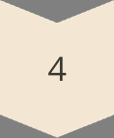


Advantages and Disadvantages
Simple
Easy to understand and implement, requiring minimal computational complexity.
Fast
Provides efficient classification, making it suitable for real-time applications.
Effective
Performs well with high-dimensional data, handling numerous features effectively.
Naive Assumption
The assumption of feature independence may not always hold true.
Sensitivity
Can be sensitive to violations of the independence assumption, leading to inaccurate results.
Zero-Frequency Problem
May struggle with words that haven't been encountered during training.

Slide 8
Methodologies
Data Collection
Collecting large datasets of emails labeled as spam or legitimate is crucial.
Feature Extraction
Common techniques include Bag of Words and TF-IDF, transforming text into numerical features.
Model Training
Training algorithms like MultinomialNB, BernoulliNB, and GaussianNB learn patterns from the data.
Evaluation
Metrics like accuracy, precision, recall, and F1-score assess the model's effectiveness.

Slide 9



System Requirements
Sufficient processing power and memory are essential for handling large datasets and calculations.
Programming languages like Python, libraries like scikit-learn, Pandas, numpy, matplotlib, nltk, are needed.

Slide 10
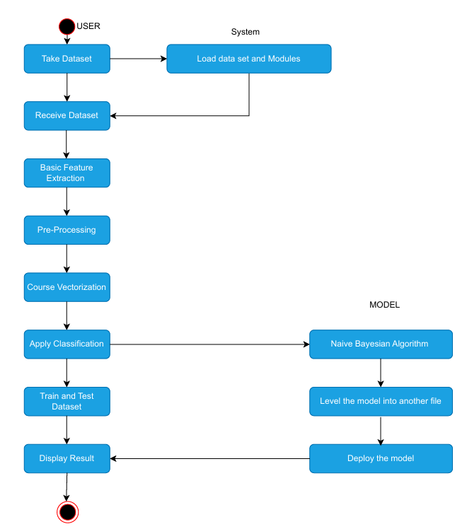
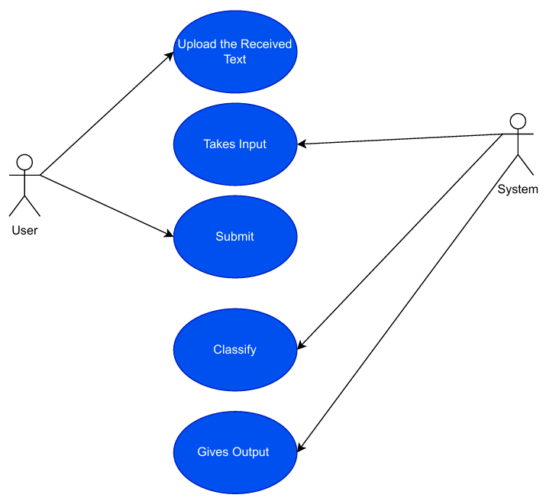
Use Case Diagram & Activity Diagram

Slide 11
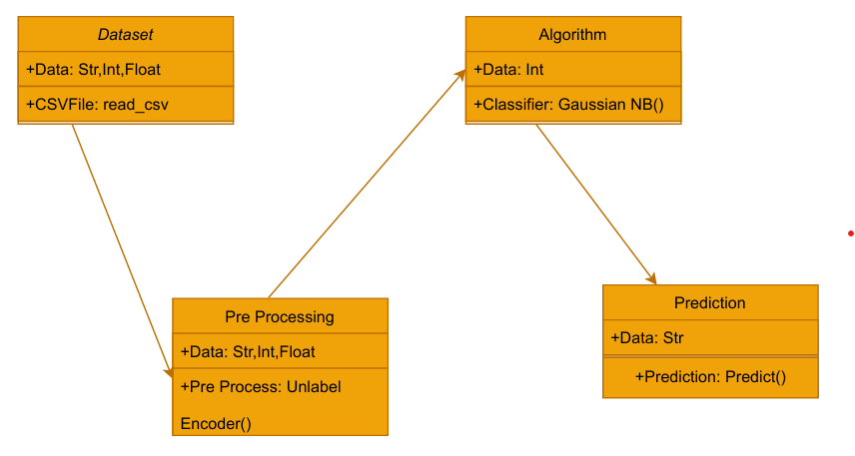
Class Diagram

Slide 12
Execution Steps
1
1. Data Preparation
Collect and preprocess data, including text cleaning and feature engineering.
2
2. Model Training
Train a Naive Bayes model on the prepared data, choosing an appropriate algorithm.
3
3. Model Evaluation
Evaluate the trained model's performance using various metrics.
4
4. Deployment
Deploy the model in a real-world system, integrating it with email clients or servers.

Slide 13



Conclusion
Improved Feature Engineering
1
More sophisticated features, like n-grams and semantic analysis, can enhance accuracy.
Hybrid Models
2
Combining Naive Bayes with other algorithms can address its limitations.
Real-Time Adaptation
3
Continuously learning and adapting to evolving spam patterns is crucial.

Slide 14


Thank you
Adapt it with your needs and it will capture all the audience attention.

